Slide 1
The Computer
Unit 4
CC7 Human Computer Interaction
Arnemie B. Gayyed

Slide 2
Table of Contents
The role of computers in HCI
Input devices
Output devices
Virtual reality devices
Biosensing
Computer memory
Computer processing

Slide 3
The Role of Computers in HCI
Interactions with computers | Computer peripherals and parts | Why know the computer devices?

Slide 4
Interaction with Computers
What are our goals when interacting with people?
How does our interactions with people relate to our interactions with computers?
Interaction is a process of information transfer.

Slide 5
Computer Peripherals and Parts
Input / output devices
Virtual Reality systems
Bio sensors
Computer memory
Computer processors

Slide 6
Why Know the Computer Devices?
Match the devices that complements the capabilities and limitations of the human
Perceptual system
Human memory and processing
Human error
Human emotions
Not every user would have all the required computer devices

Slide 7
Input Devices
Keyboard | Mouse | Microphone | Trackball | Touchpad |Touchscreen Devices | Controllers | Scanner | Drawing Tablet | Eye Tracking Devices | Hand Tracking Devices

Slide 8
List of Input Devices
Keyboard
Mouse
Microphone
Trackball
Touchpad
Touchscreen devices
Controllers
Scanner
Drawing Tablet
Eye Tracking Devices
Hand Tracking Devices

Slide 9
Input Device – Keyboard
Like a typewriter, it is composed of buttons used to create letters, numbers, and symbols, and perform additional functions
Buttons or keys act as mechanical levers or electronic switches
Arrangement of buttons depend on the format:
QWERTY
QWERTZ
AZERTY
DVORAK

Slide 10
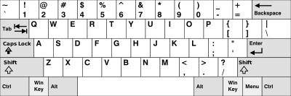
Input Device – Keyboard
QWERTY / Sholes Keyboard
Named after the first 6 alphabetic keys on the top left
May be created:
Due to mechanical failings in early typewriters
To make it easier to decode morse code

Slide 11
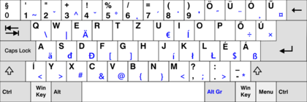
Input Device – Keyboard
QWERTZ / Swiss Keyboard
Used in German-speaking countries

Slide 12
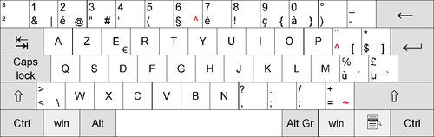
Input Device – Keyboard
AZERTY Keyboard
Commonly used in France and Belgium

Slide 13
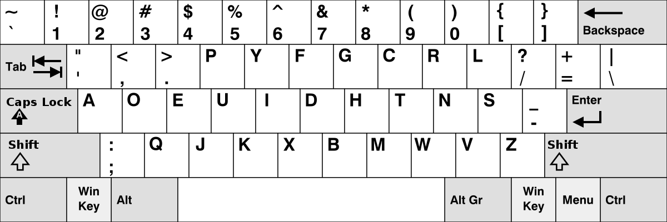
Input Device – Keyboard
DVORAK Keyboard
Ergonomic alternative to the QWERTY layout
All vowels and punctuation marks are on the left side
All consonants on the right side
Most used letters in the middle row so it’s easier to reach

Slide 14
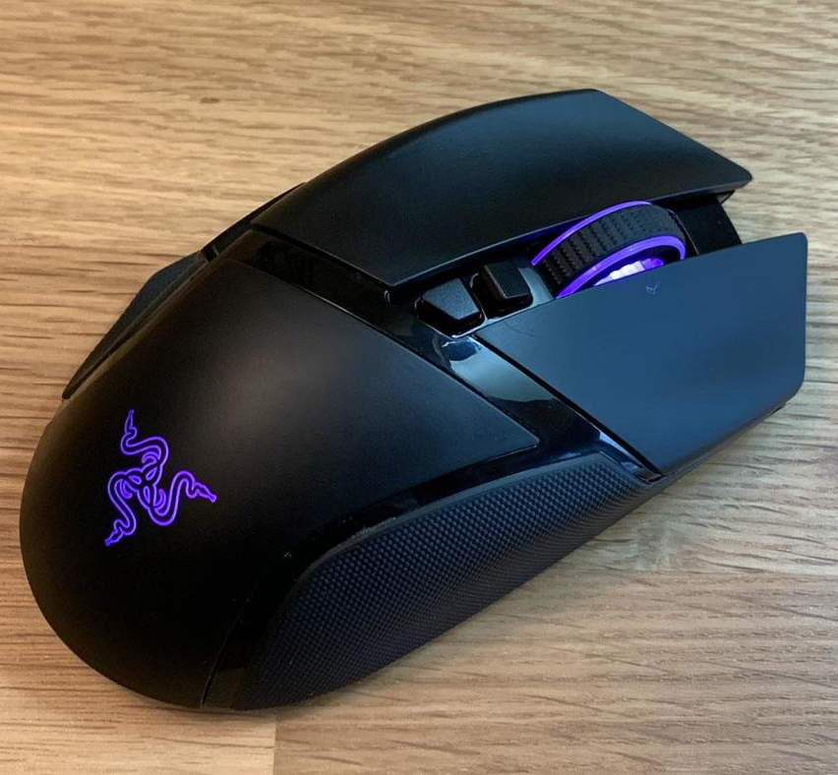
Input Device – Mouse
Handheld hardware input device that controls a cursor in a GUI (graphical user interface)
Move and select text, icons, files, and folders on computer
Commonly makes use of a pointer on a display
Types:
Ambidextrous
Left-handed
Vertical

Slide 15
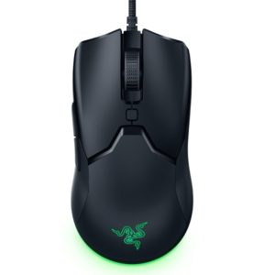
Input Device – Mouse
Ambidextrous Mouse
Designed to fit either left-handed or right-handed people
Most common type of mouse

Slide 16
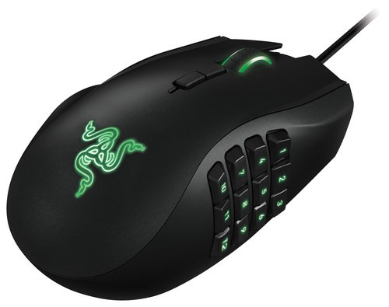
Input Device – Mouse
Left-Handed Mouse
Specifically designed for users whose dominant hand is their left hand

Slide 17
Input Device – Mouse
Vertical Mouse
Taller than it is wide
Designed to reduce strain
Mouse is held vertically, much like you would during a handshake
Buttons are located right beneath the grasp

Slide 18
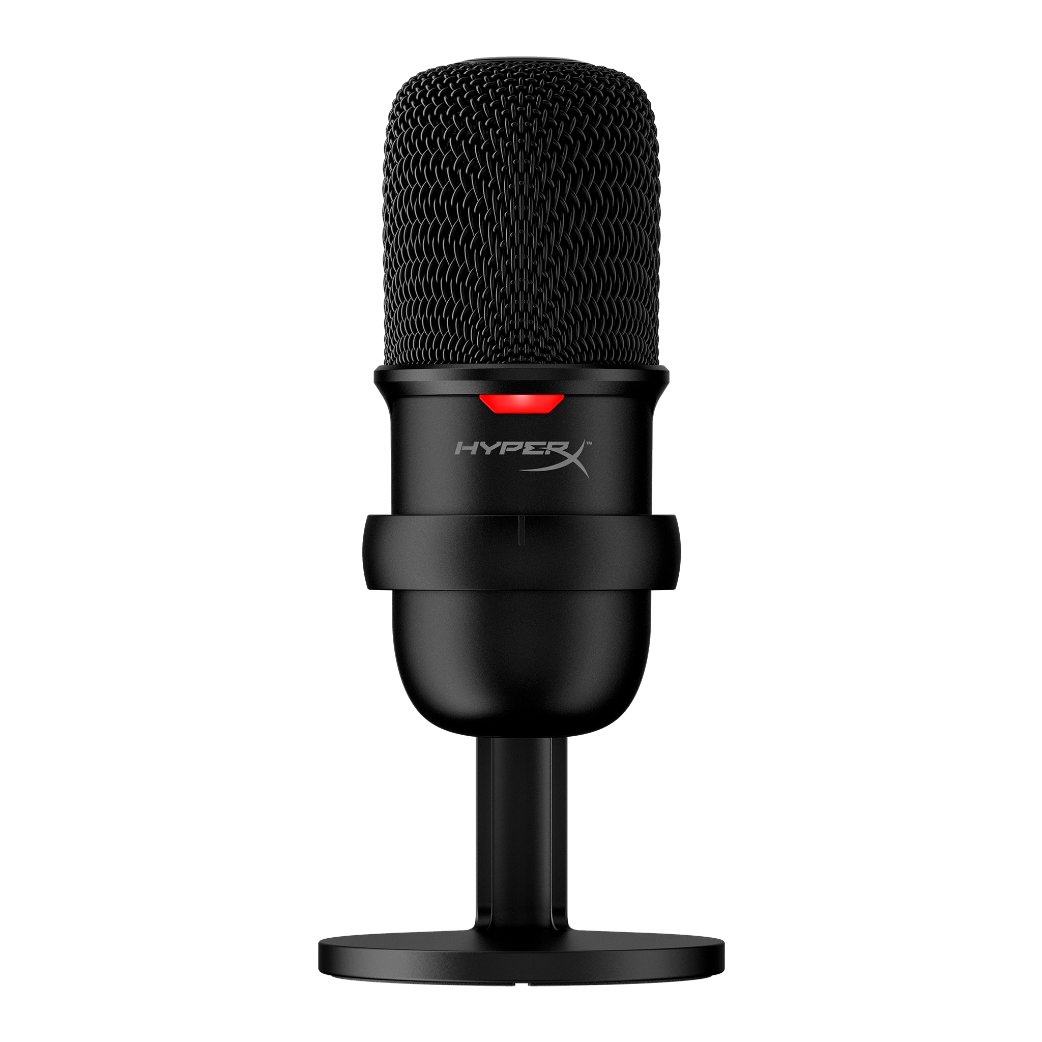
Input Device – Microphone
Translates sound vibrations in the air into electronic signals or scribes them to a recording medium

Slide 19
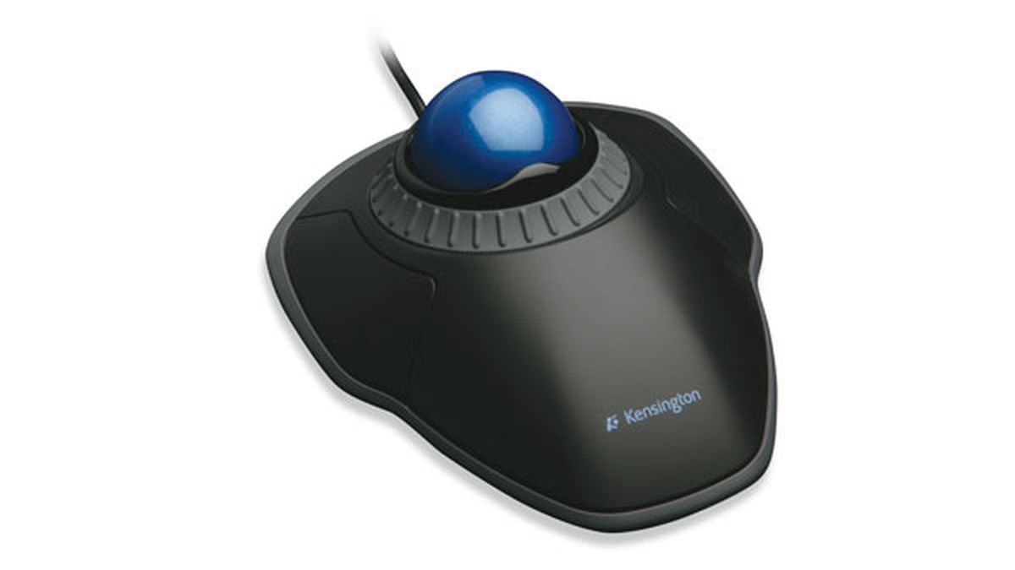
Input Device – Trackball
Small ball set in a holder
Can be rotated by hand to move a cursor on a computer

Slide 20
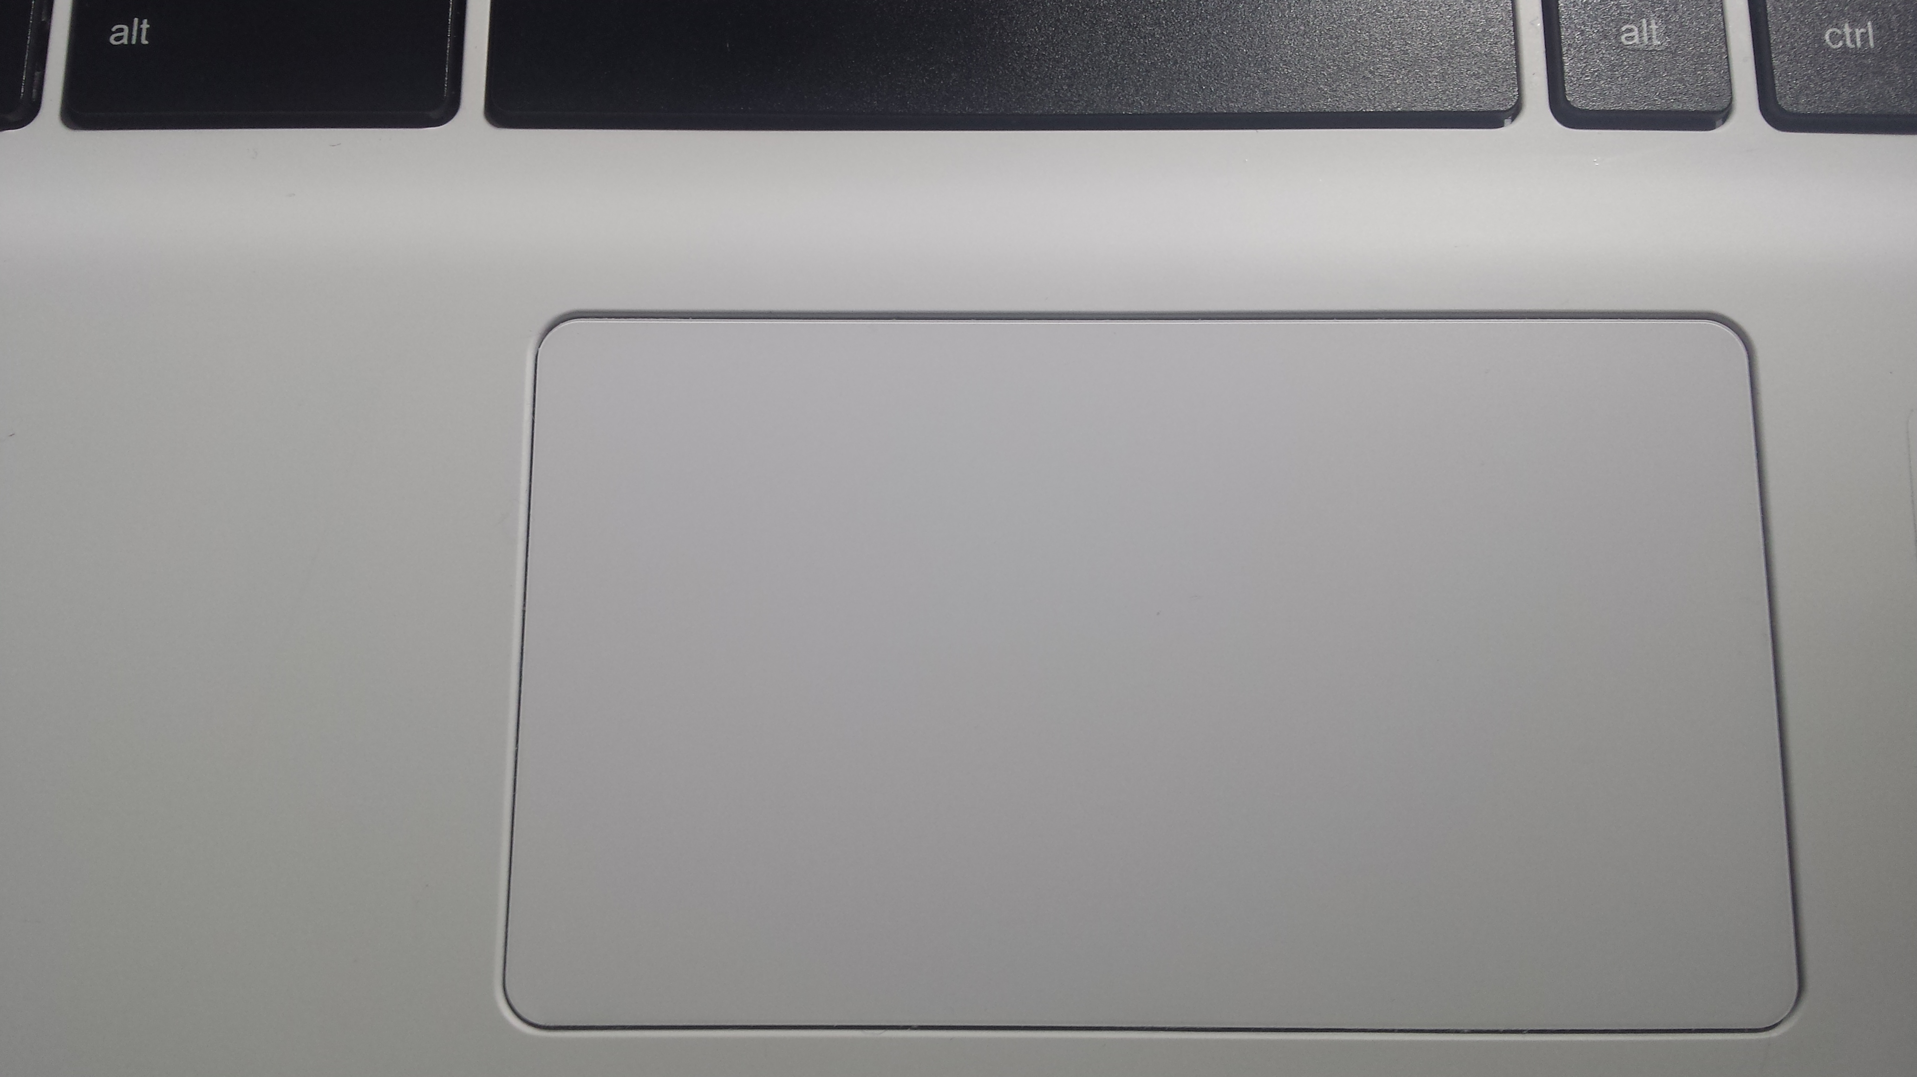
Input Device – Touchpad
For controlling the pointer on a display screen
Done by sliding the finger along a touch-sensitive surface

Slide 21
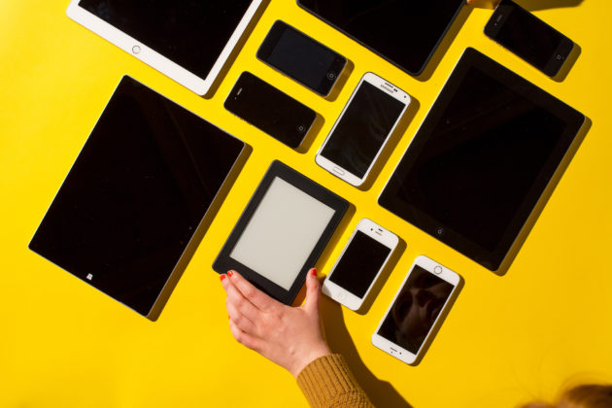
Input Device – Touchscreen Devices
Technically both an input and output device
User places input through multi-touch gestures by touching the screen or through a stylus
Output may be shown in another screen or in the same screen

Slide 22
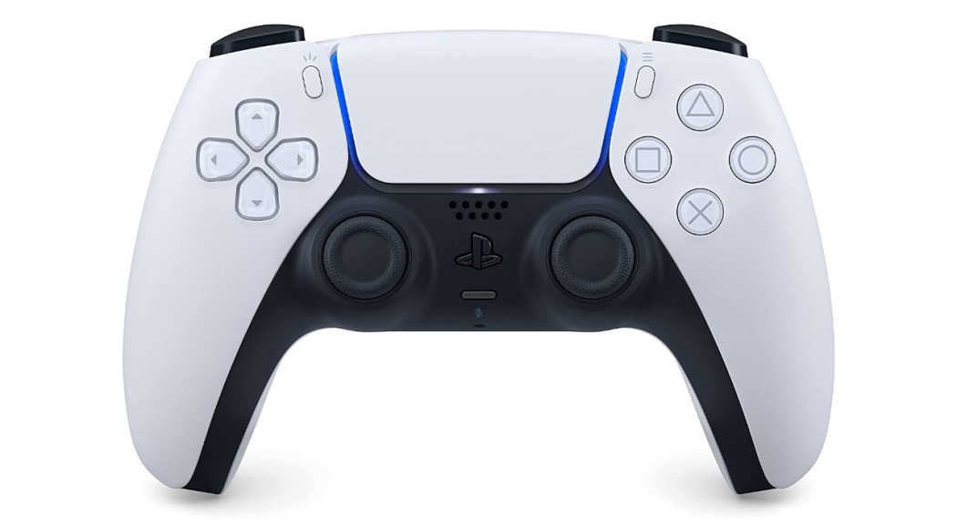
Input Device – Game Controller
Also known as a gaming controller or controller
Used to provide input to a video game
Can be haptic
Gamepad
Common game controller
Came from console games
Used for better mobility of a character

Slide 23
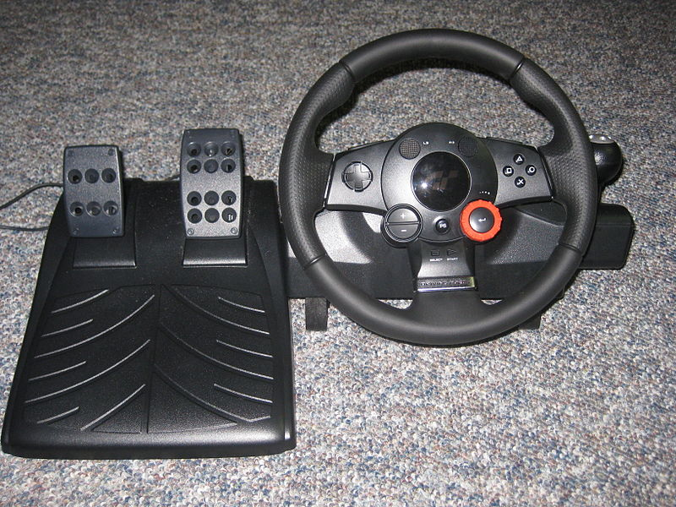
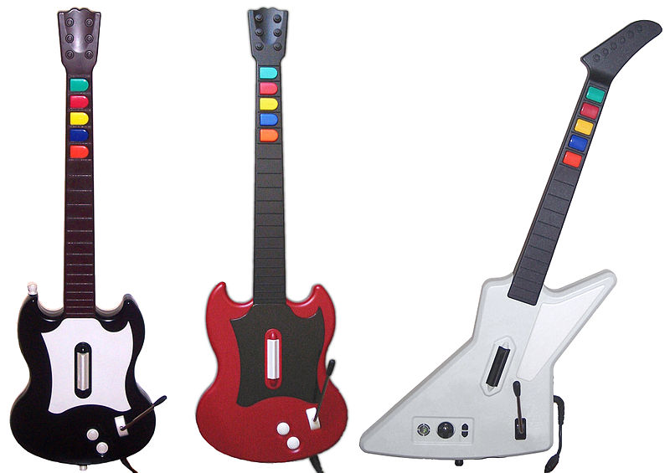
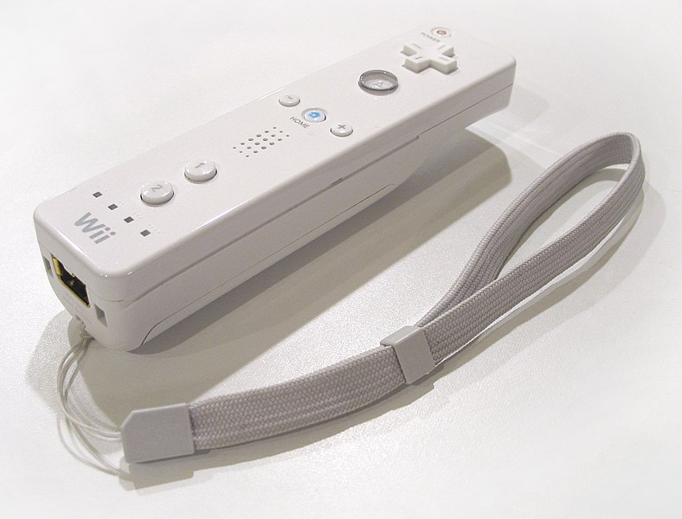
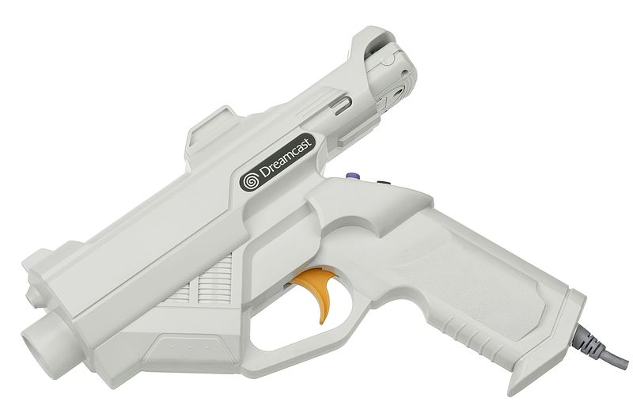
Input Device – Game Controller
Other game controllers
Paddle
Steering wheel set
Touchscreen
Motion sensor
Light gun
Rhythm game controllers

Slide 24
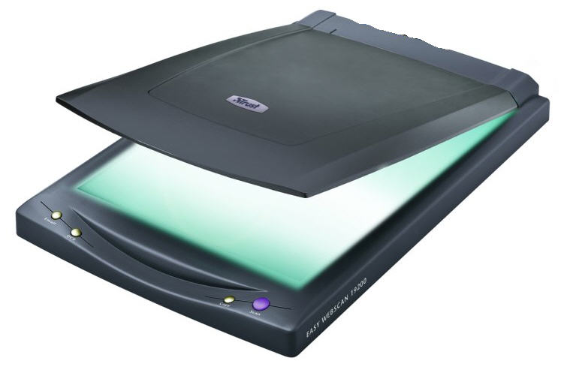
Input Device – Scanner
Uses a light beam to scan codes, text, or graphic images directly into a computer or computer system

Slide 25
Input Device – Drawing Tablet
Converts movements from a stylus pressed on a designated area on the tablet’s screen
Commonly used for digital arts

Slide 26
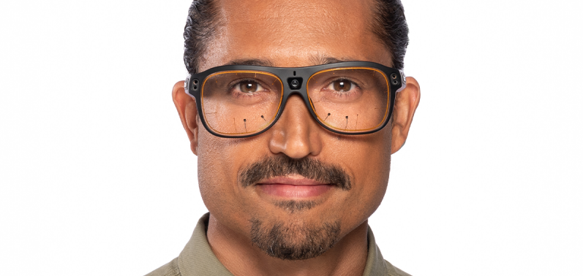
Input Device – Eye Tracking Device
Sensor technology that makes it possible to know where a person is looking in real-time
Uses a specialized camera
Detects the presence, attention, and focus of the user

Slide 27
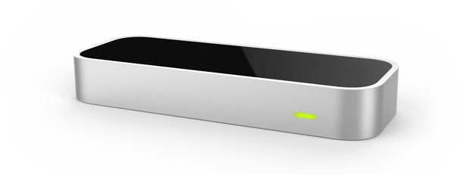
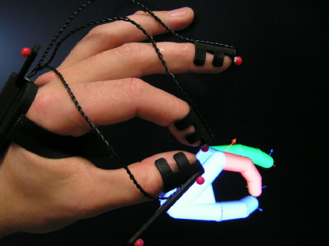
Input Device – Hand Tracking Device
Makes use of various sensors
Captures data on the position, orientation, and velocity of hands
Can be a device that is attached to the hand or a device away from the hand

Slide 28
Output Devices
Monitor | Speaker | Headphone | Printer

Slide 29
List of Output Devices
Monitor
Speakers
Headphones
Printers

Slide 30
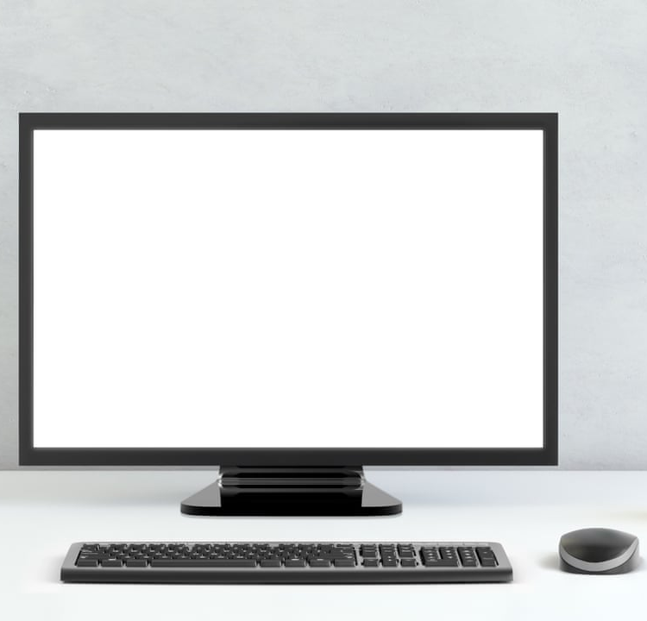
Output Device – Monitor
Displays information in pictorial or text form
Modern monitors use liquid crystal display (LCD)
Three popular LCD monitor types:
Twisted nematic (TN)
IPS (In-Plane Switching)
VA (Vertical Alignment)

Slide 31
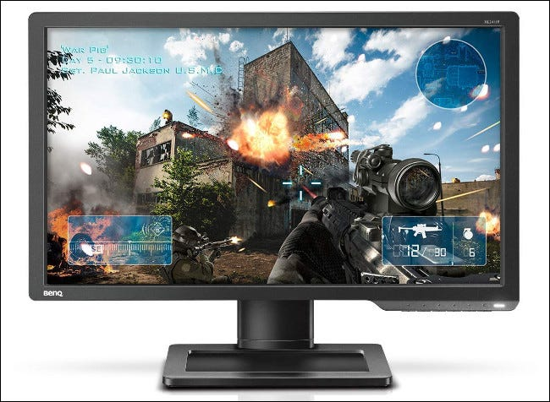
Output Device – Monitor
Twisted Nematic (TN) Panels
Oldest type of LCD panel
Most budget-friendly; has low cost production
Limited viewing angles, particularly on vertical axis
High refresh rates; low input lag
Colors of the TN panels:
Reproduction is not strong
Can invert completely when viewed from an extreme angle

Slide 32
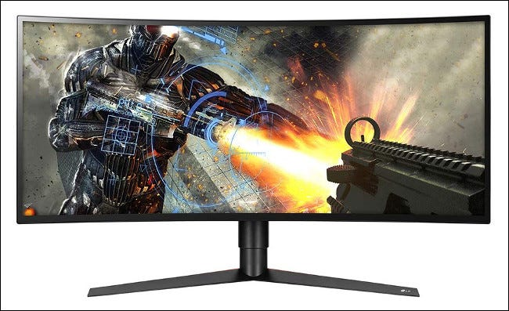
Output Device – Monitor
In-Plane Switching (IPS) Panels
Developed to improve limitations of TN panels
Vastly superior viewing angles
Best color reproduction:
Good black color reproduction
Best used for graphic design

Slide 33
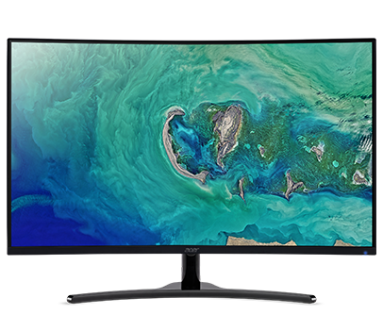
Output Device – Monitor
Vertical Alignment (VA) Panels
Compromise between TN and IPS
Has best contrast ratios
Used extensively for TV manufacturing
Viewing angles are in the middle of IPS and TN
Have slower response times than TNs
Ideal for general use

Slide 34
Output Device – Speakers
Connects to a computer to generate sound
Signal is created by the computer's sound card

Slide 35
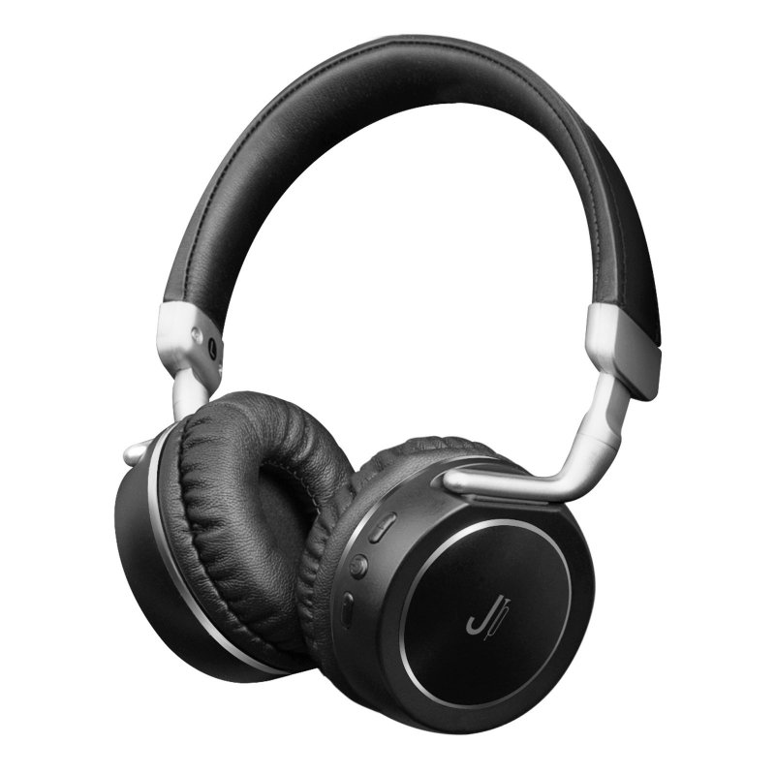
Output Device – Headphones
Small speakers that can be worn in or around the ears
Traditional headphones:
Have two ear cups
Attached by a band
Placed over the head
Earbuds or earphones:
Placed inside the outer part of the ear canal

Slide 36
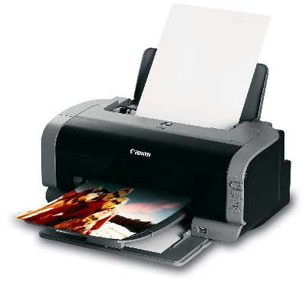
Output Device – Printer
Accepts text and graphic output from a computer
Traditional printers transfer the information to paper

Slide 37
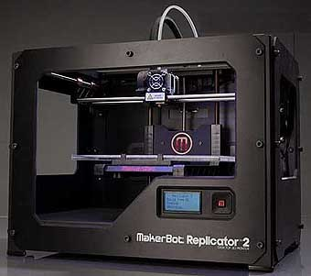
Output Device – Printer
3D Printer
Computer-aided manufacturing (CAM) device
Creates three-dimensional objects
Builds a three-dimensional model out of a custom material

Slide 38
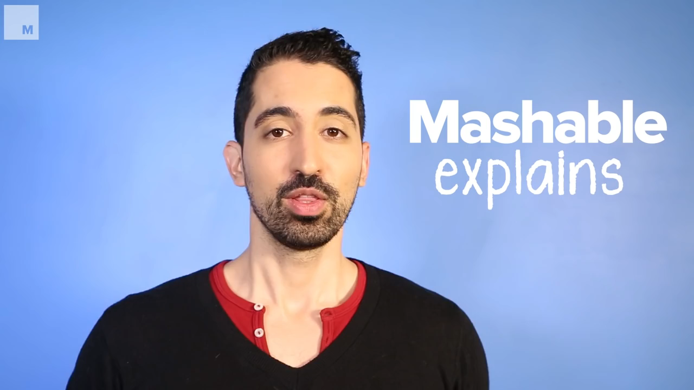

Slide 39
Virtual Reality Systems
What is virtual reality? | VR headset | Motion controllers | Optical tracking

Slide 40
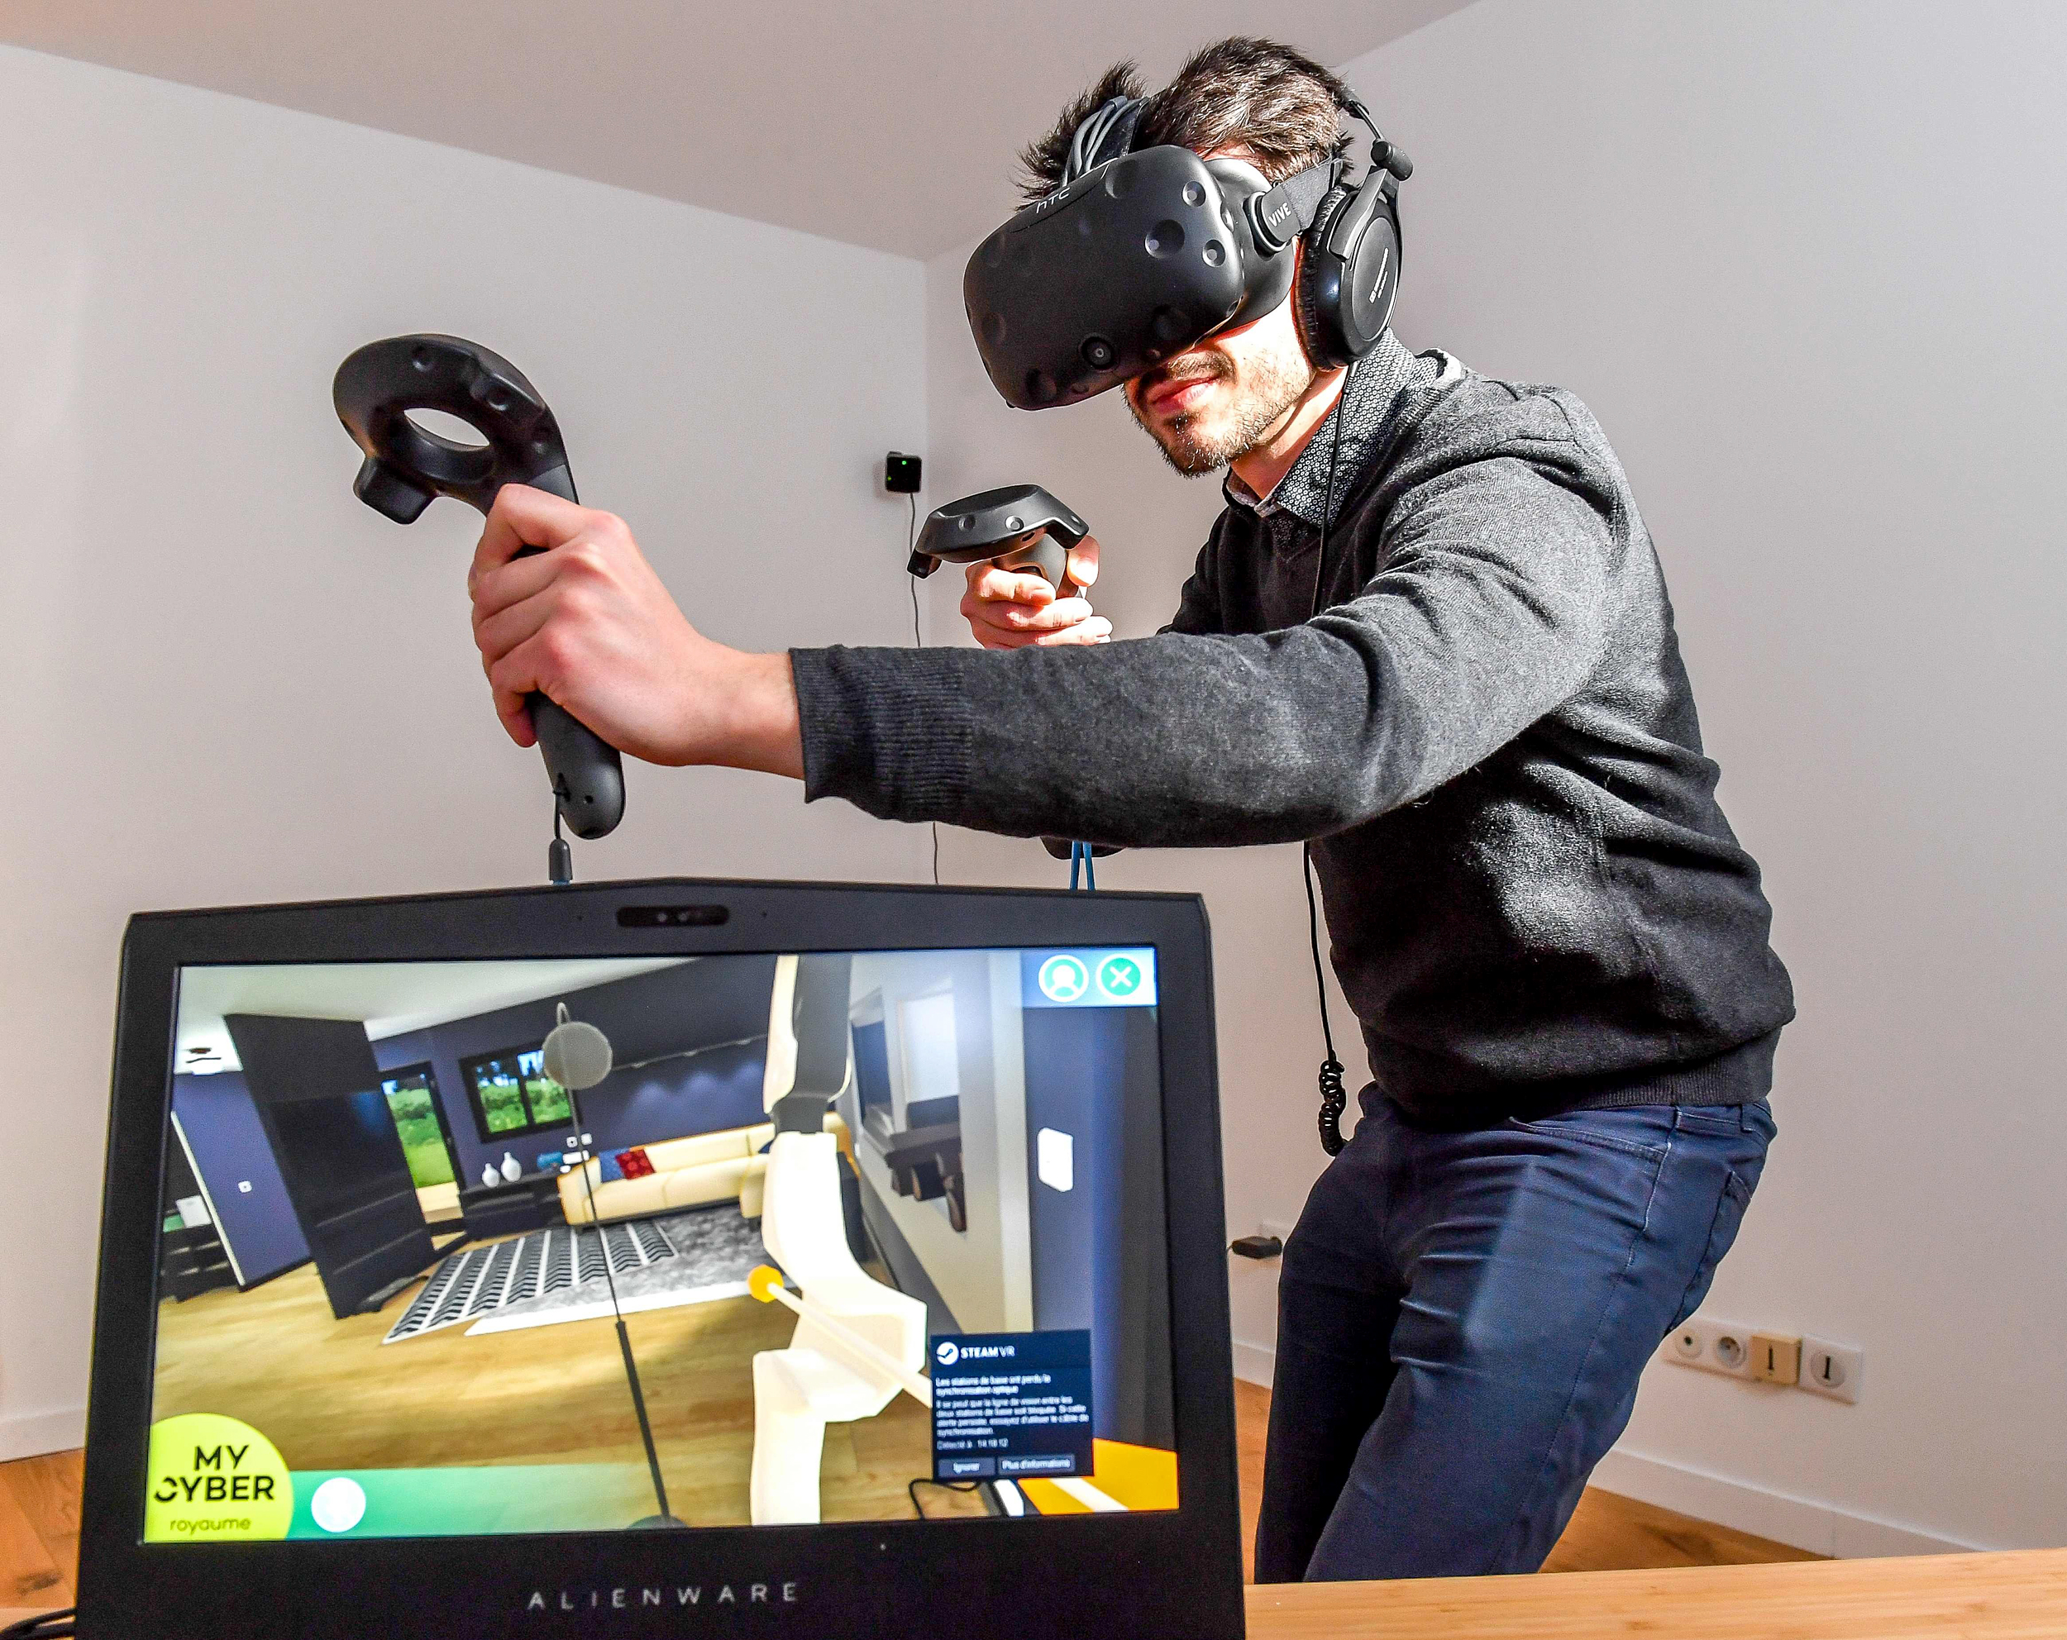
What is Virtual Reality?
Simulated experience that can create an artificial world
Can look and move around the artificial world, and interact with objects around
Utilizes limited visual and auditory processing and high haptic feedback for a more immersive experience

Slide 41
Virtual Reality Devices
Virtual reality headset
Motion controllers
Optical tracking

Slide 42
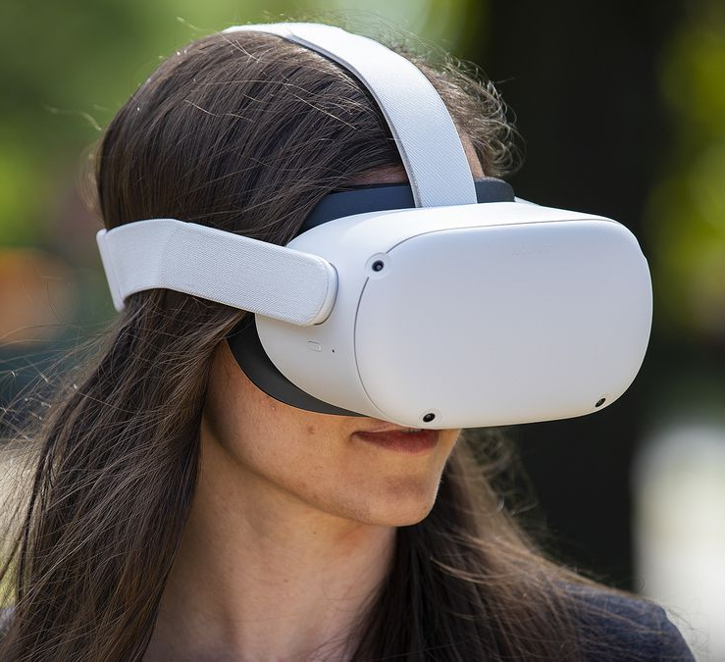
VR Device - Headset
Also called VR goggles
Head-worn apparatus that completely covers the eyes for an immersive 3D experience
Can be attached to a computer (Valve Index)
Can be self-contained (Oculus Quest 2)

Slide 43
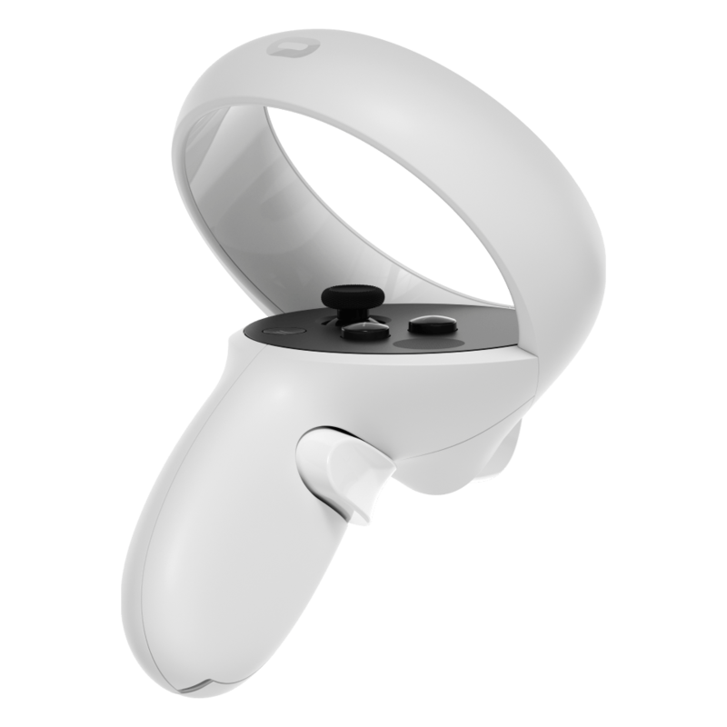
VR Devices – Motion Controllers
Collection of devices that detect the user’s motion in different levels
Tracked with cameras, sensors in the controllers, or both
Examples:
Hand controllers
Wired glove
Omnidirectional treadmill

Slide 44


Slide 45
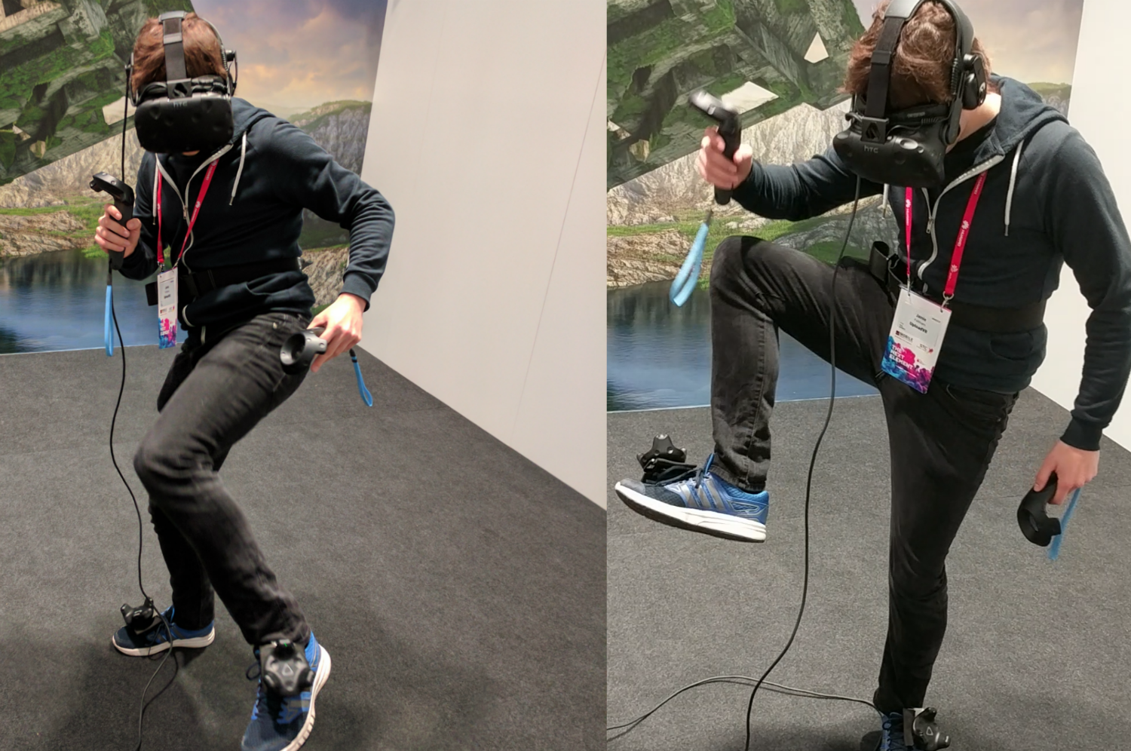
VR Devices – Optical Tracking
Process of monitoring the user’s position through visual information
Mostly done through sets of cameras and other sensors in or out of the headset
Can track smaller body parts (fingers) to the entire body

Slide 46

VR - Mojo Contact Lens

Slide 47
Bio Sensors
What is biosensing? |Biosensors | Brain sensors

Slide 48
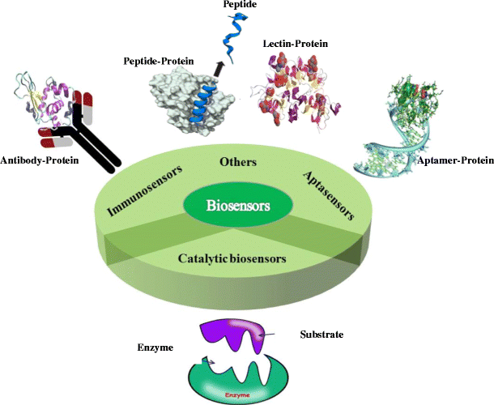
What is Biosensing?
Detection of target molecules based on the principles used by a living system
Can be used for a more precise means of determining user input with little movement

Slide 49
Biosensor
Self-contained integrated device
Capable of providing specific quantitative analytical information using a biological recognition element
Enzymes
Antibodies
Natural receptors
Cells

Slide 50
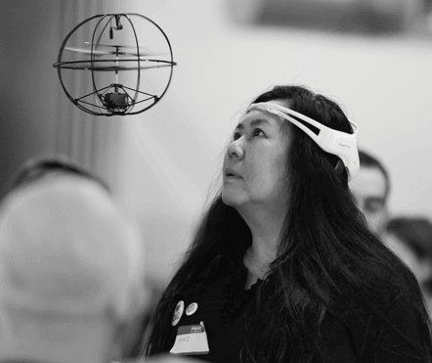
Brain Sensors
Can allow to control software, apps, and machines
Done by developing new virtual reality, augmented reality, and brain-controlled technology with brain-computer Interface (BCI) software

Slide 51
Computer Memory
Non-volatile memory | Volatile memory

Slide 52
Computer Memory Devices
Non-volatile memory
Hard disk drive
Solid state drive
Flash memory
Nonvolatile memory express
Volatile memory
Random access memory

Slide 53
Non-Volatile Memory
Type of computer memory that can retain stored information even after power is removed
Common examples:
HDD (Hard Disk Drive)
Flash memory
SSD (Solid State Drive)
NVMe (Nonvolatile Memory Express)

Slide 54
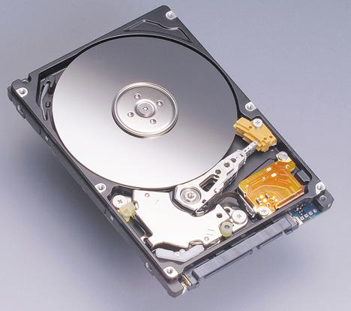
Non-Volatile Memory
Hard Disk Drive (HDD)
Magnetic storage medium for a computer
Hard disks are flat circular plates made of aluminum or glass and coated with a magnetic material
Used for general storage, but quite slower

Slide 55
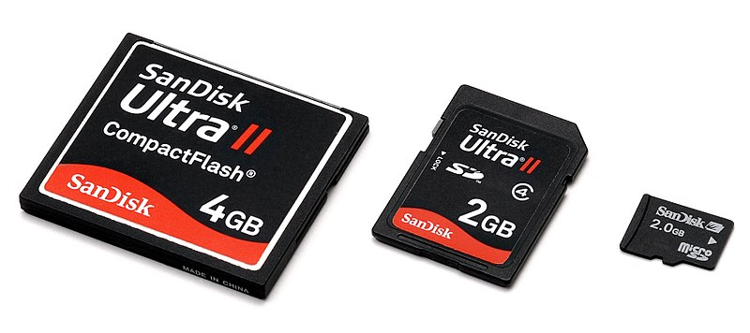
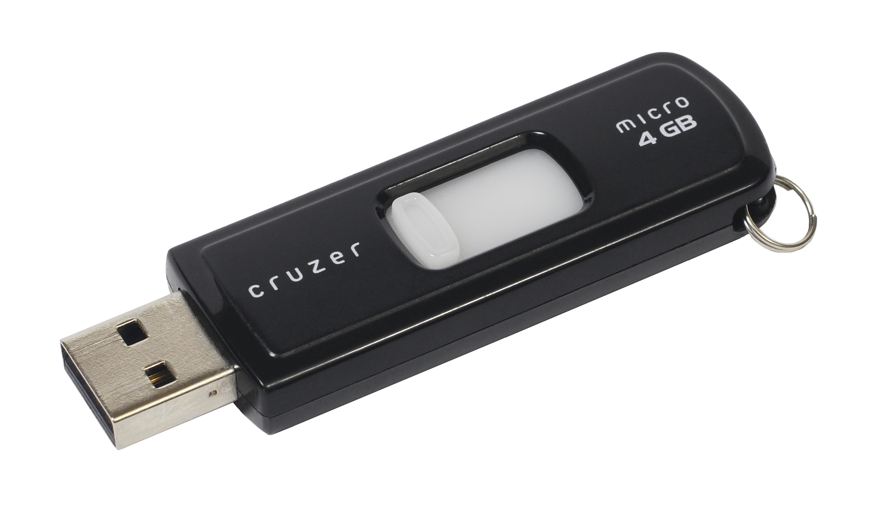
Non-Volatile Memory
Flash Memory
General term for electronic non-volatile memory
Can be electrically erased and reprogrammed
Used for a lot of modern memory devices:
USB flash drives
Memory cards
SSDs and NVMes

Slide 56
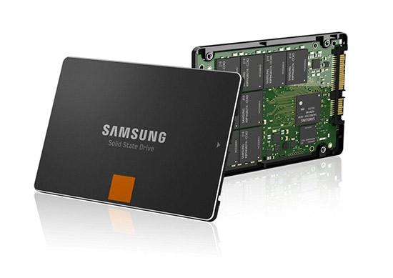
Non-Volatile Memory
Solid State Drive (SDD)
New generation of storage device used in computers
Uses flash-based memory
Much faster than a traditional mechanical hard disk
Used for more modern systems that require fast access of storage

Slide 57
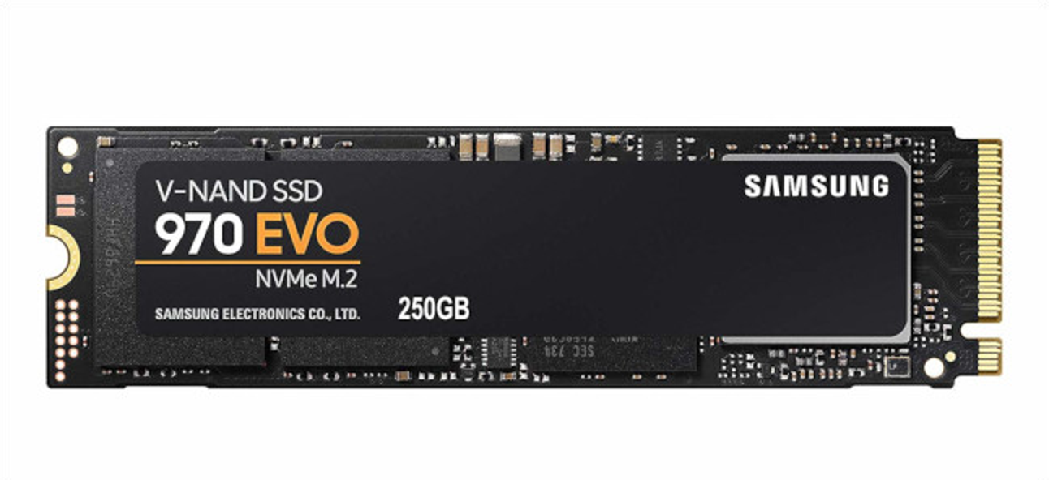
Non-Volatile Memory
Nonvolatile Memory Express (NVMe)
New storage access and transport protocol for flash and next-generation solid-state drives
Delivers the highest throughput and fastest response times yet for all types of enterprise workloads

Slide 58
Volatile Memory
Computer memory that only maintains its data while the device is powered
Used for primary storage in personal computers
Much faster to read from and write to than the other kinds of storage in a computer
Data stored in volatile memory are temporary data used in computer systems or ones needed by the processor

Slide 59
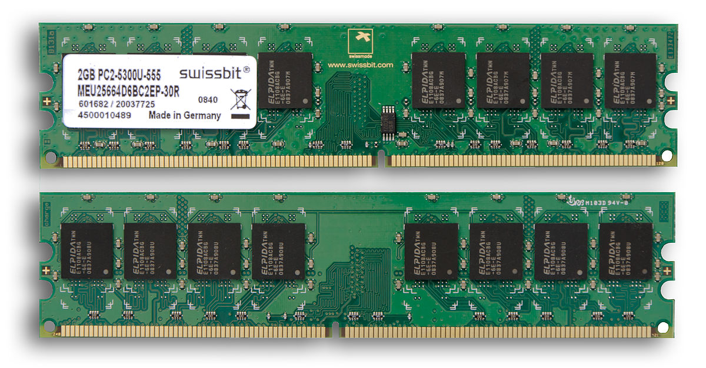
Volatile Memory
Random Access Memory (RAM)
Short-term memory where data is stored as the processor needs it
Play a game from computer’s hard drive
Stream a movie from the Internet
Processor can get to the data quickly

Slide 60
Computer Processors
Computer processing and processors | Limitations that decrease processor performance

Slide 61
Computer Processing
Processing can be too slow or too fast
Too slow
Unable to catch input when it happens
Input is buffered; feedback is too slow
Too fast
Output comes out too quickly; user is unable to read it

Slide 62
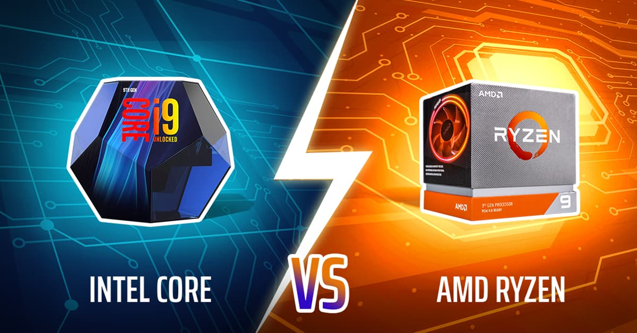
Computer Processor
Central Processing Unit
Circuit board inside a computer that executes instructions on behalf of programs
Modern computer processors can process millions of instructions in a second
Processors are considered the main chip on a computer

Slide 63
Computer Processor
Limitations that Decrease Processor Performance
Computation limitations
Storage channel limitations
Graphics limitations
Network limitations

